Slide 1
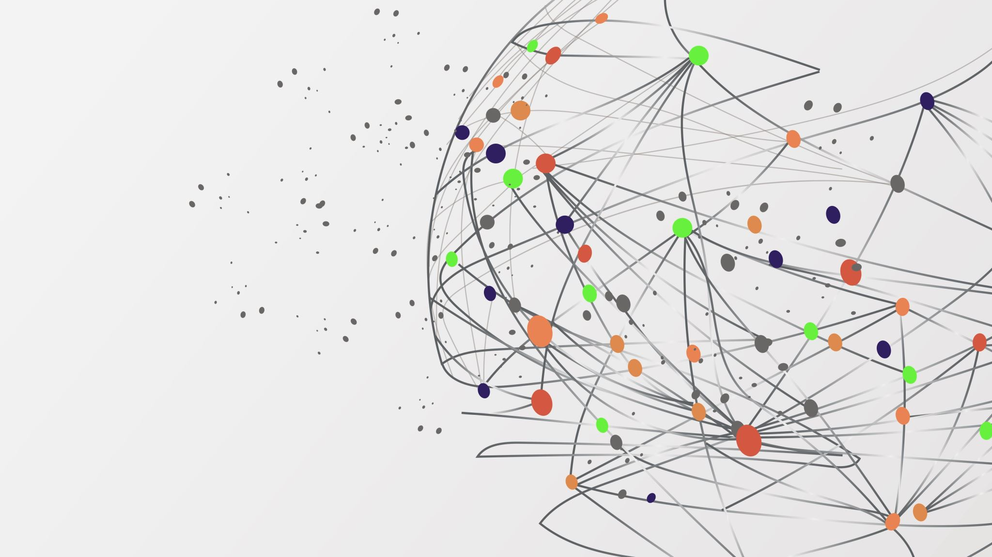
SPRINT-2 PROJECT Team-D
B.Sahari
Mohd Alishan
Aman Barik
Anshul

Slide 2
Title: React JS based "WhatsApp Clone”
Objective:
"There is no better way to understand a framework, library and its features, than by making projects."
We will be making the following features :
WhatsApp Web UI
Create rooms or groups
Sign in with Google account
Last seen for groups
Messaging boxes [green for own and white for the replies of others]
Send message in group with timestamp

Slide 3
Learning Scope :
This project will give us a hands-on experience with the React library. Fullstack development currently has many different stacks and technologies to learn. React is one of the most popularly used Frontend libraries used by companies such as Facebook, Pinterest, Uber, Instagram and many more. You will learn not just about UI designing but also integrating it with the backend.
You will be learning about :
Basics of React
Functional Components
useState
useEffect
Props
Context API
Material- UI (Design)
Firebase
Authentication
Firestore(Database)

Slide 4

Project Stages :
We can break down the project in the following stages:
Front-end
Sidebar Component
Chat Component
Login Page
Back-end
Authentication
Database(Firestore)

Slide 5
High-Level Approach :
Identify the UI components and segregate them into smaller components
Start with building individual components with static data which will be replaced by real time data later
CSS styling and Material-UI icons implementation
Setup project on Firebase
Configure and install Firebase in your React project
Design the database for your requirement
Authentication - Add authentication in your project to access the chat section only after authenticating with google account.
Integration of data with UI

Slide 6
Stages of implementation :
1. File Structure and Dependencies installation
Before you get started with building the components it is better to plan your components. This will give you a clear idea on what goes where.
Requirements :
Create React app using create-react-app command.
Your file structure should look like the image below.

Slide 7
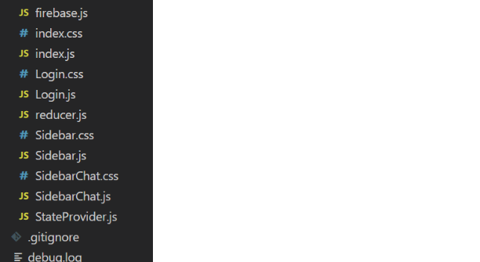

Slide 8
There are multiple dependencies that you need to install to get started with your project.
"dependencies": {
"@material-ui/core": "^4.11.0",
"@material-ui/icons": "^4.9.1",
"@testing-library/jest-dom": "^5.11.4",
"@testing-library/react": "^11.1.0",
"@testing-library/user-event": "^12.1.10",
"firebase": "^8.2.1",
"react": "^17.0.1",
"react-dom": "^17.0.1",
"react-router-dom": "^5.2.0",
"react-scripts": "4.0.0",
"web-vitals": "^0.2.4"
},

Slide 9
Expected Outcome :
You should be able to successfully install the React application with all the required dependencies. You can check the package.json file for verification.

Slide 10
2. Frontend Design Implementation
App Components :
Now we can start designing your UI components. For UI components you can refer the below image. It basically has two major components:
Sidebar Component
Sidebar header [with account avatar and icons]
Sidebar Search
Sidebar Chat List
Chat section Component
Chat header
Chat Body
Chat Footer

Slide 11
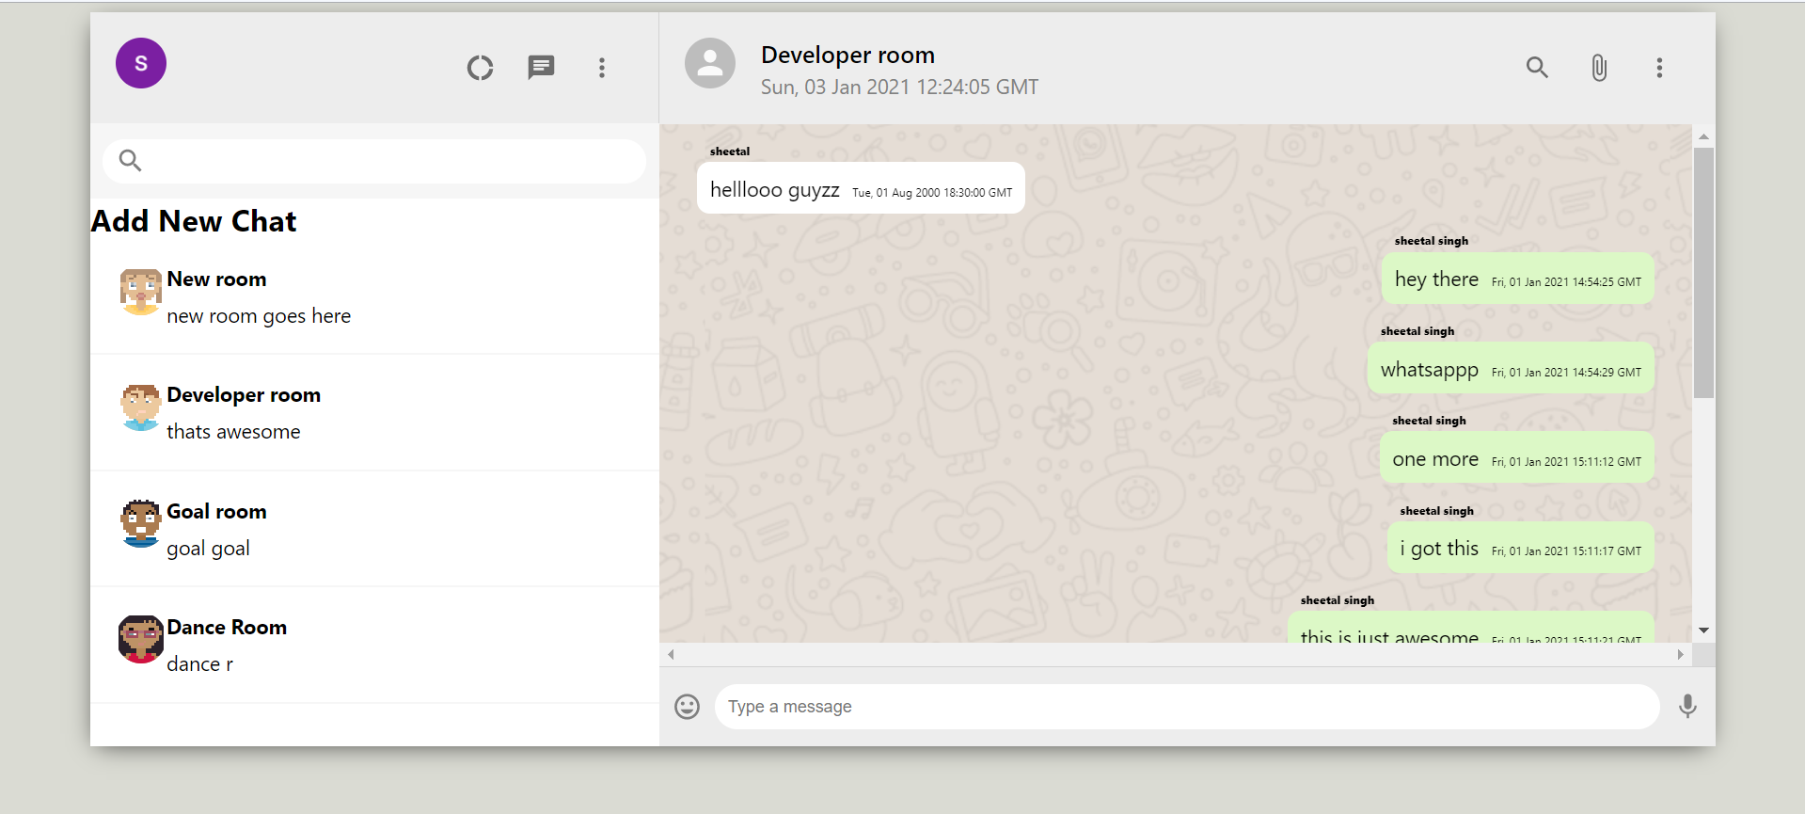
Requirements :
Design the components to make it similar to the above screenshot.
Additional requirements:
The header icons should be clickable.
There should be a input section for search and chat box.
The page should be responsive.

Slide 12
Bonus :
The material-UI icons used for this WhatsApp clone are
SearchIcon
MoreVertIcon
AttachFileIcon
MicIcon
InsertEmoticonIcon
DonutLargeIcon
ChatIcon

Slide 13
3. Firebase Project Setup
Firebase :
Firebase is a cloud platform provided by Google to enable mobile and web application development. We will be using Firebase for Google authentication and Firebase Firestore for NoSQL database for our chat application.
Requirements :
Create a Firebase project for your application.
Create a Firestore database.
Find a method to ensure that your Firestore is connected to your React app once the configuration file firebase.js is in place.

Slide 14
4. Database design and Configuration
Component :
After the UI gets ready, now is the time to fetch the data from the database. You need to make different states to manage different components. Those states will be responsible to push data to your Firestore database and get data and display them in real time.
Requirements :
Design your Firestore collection according to the requirement of the chat application. for example, your will make a collection of rooms that hold room name and id. Those individual rooms hold a collection of chats with chat message, sender name and timestamp (for last seen and message time).
Fetch the required data from the configured Firestore DB.
Replace the static data from the database data.

Slide 15
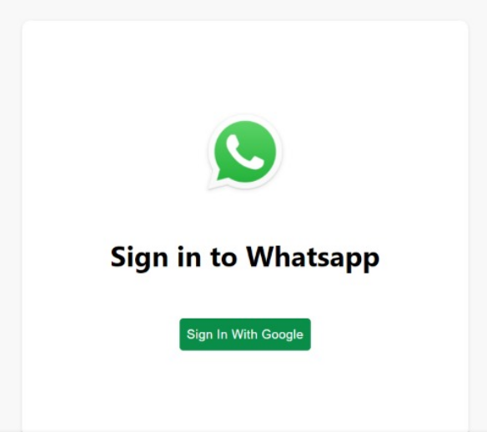
5. Add Authentication
As the final stage, we'll be adding a form of authentication to our application. For keeping it simple, we'll be integrating Sign In With Google with the React application.
Requirements :
Login page to redirect to Google authentication prompt.

Slide 16
Chat section with Google ID avatar on successful login. (Refer to the image of the UI)
Use conditional rendering to add a class of sender (green box) and others (white box) as the chats, as we have in WhatsApp originally. You can use user display name and Google auth id name to add the condition.
Now let's Deploy the application using Firebase.
Expected Outcome :
This would be the final stage of our project. Everyone should be able to sign in with your Google account, have you chats saved and able to send and receive chats.

Slide 17
THANK YOU

